Slide 1
Recipe Roundtable
Uniting Friends with Food
Capstone Project for IOD by Thomas Ellis
Notes:
© Copyright PresentationGO.com – Free Templates & Infographics for PowerPoint and Google Slides

Slide 2
Introduction
Purpose and Reason Behind Recipe Roundtable
Notes:
© Copyright PresentationGO.com – Free Templates & Infographics for PowerPoint and Google Slides

Slide 3
The Reason behind the Roundtable
Cooking is one of life’s most essential skills. I was horribly lacking in that category for most of my life. That all changed with my friends coming together and teaching each other some of our favorite recipes during the lost years. I still remember the first class I “taught”. Frozen chicken tenderloins and some boiled broccoli. Mine was not a very popular dish. I was more of a takeout person back then.
Notes:
© Copyright PresentationGO.com – Free Templates & Infographics for PowerPoint and Google Slides

Slide 4
The Reason behind the Roundtable
Home cooking can be daunting. I know it was for me. So many choices of recipes and incredible professional level photos that leave your mouth watering. You try the same recipe, put in a ton of effort and it turns out poorly, and now you don’t want to cook anything the rest of the week. Recipe Roundtable is here to combat the fears of starting off as a home cook.
Notes:
© Copyright PresentationGO.com – Free Templates & Infographics for PowerPoint and Google Slides

Slide 5
Introduction
Why don’t more people cook at home and the cooking industry
Notes:
© Copyright PresentationGO.com – Free Templates & Infographics for PowerPoint and Google Slides

Slide 6
The Truth on Home Cooking
On average, Americans eat out for 1-4 meals per week.
The average cost of those meals has skyrocketed since 2020
The average take-out meal is 5x more expensive than a home cooked meal.
45% of Americans say they hate cooking
Notes:
© Copyright PresentationGO.com – Free Templates & Infographics for PowerPoint and Google Slides

Slide 7
The Education of a Home Cook
Many people refuse to cook at home because of how daunting the prospect can be to learn all the nuances of cooking.
Mastering cooking techniques
Understanding food science
Nutritional needs and how to meet them
Cultural cuisines that can be hard to learn
Coming up with your own flavor profiles and recipes
Notes:
© Copyright PresentationGO.com – Free Templates & Infographics for PowerPoint and Google Slides

Slide 8
How Recipe Roundtable means to help
Recipe Roundtable intends to be a one stop spot for everything a homecook might need.
Recipes with video tutorials
Sharing recipes with friends and family
Cooking techniques explained
Food science and spice mixing education
Tutorials on the latest food trends
Notes:
© Copyright PresentationGO.com – Free Templates & Infographics for PowerPoint and Google Slides

Slide 9
The Stakeholders of Recipe Roundtable
Users
Recipe Roundtable is designed for people of all ages to come and find recipes to cook as well as get help in deciding what to cook. Eventually users will be able to store their own recipes and will be able to favorite others’ recipes and share their own with friends and family.
Notes:
© Copyright PresentationGO.com – Free Templates & Infographics for PowerPoint and Google Slides

Slide 10
The Stakeholders of Recipe Roundtable
Contributors
Recipe Roundtable is made for people from all walks of life to be contributors, but I want restaurants and influencers to be able to partner with the site and share their own recipes. I want to help grow the audience for local restaurants by featuring a single recipe, or just images to help drive traffic to their locations.
Notes:
© Copyright PresentationGO.com – Free Templates & Infographics for PowerPoint and Google Slides

Slide 11
The Stakeholders of Recipe Roundtable
Contributors
Recipe Roundtable is made for people from all walks of life to be contributors, but I want restaurants and influencers to be able to partner with the site and share their own recipes. I want to help grow the audience for local restaurants by featuring a single recipe, or just images to help drive traffic to their locations.
Notes:
© Copyright PresentationGO.com – Free Templates & Infographics for PowerPoint and Google Slides

Slide 12
Product Architecture
Notes:
© Copyright PresentationGO.com – Free Templates & Infographics for PowerPoint and Google Slides

Slide 13
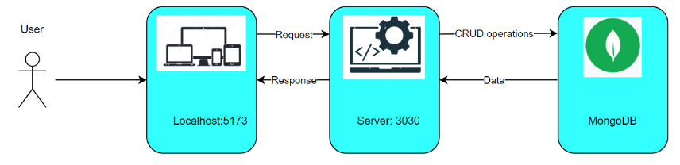
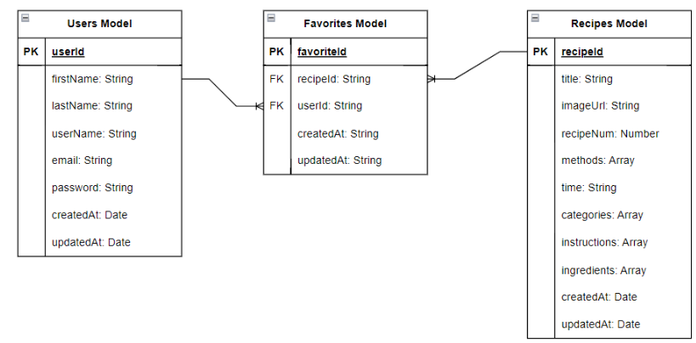
Notes:
© Copyright PresentationGO.com – Free Templates & Infographics for PowerPoint and Google Slides

Slide 14
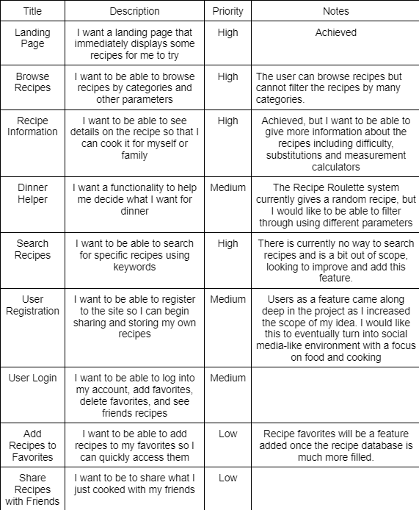
User Stories
Contributors
Notes:
© Copyright PresentationGO.com – Free Templates & Infographics for PowerPoint and Google Slides

Slide 15
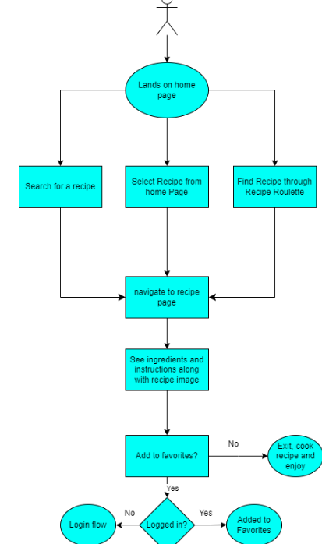
User Flow
Notes:
© Copyright PresentationGO.com – Free Templates & Infographics for PowerPoint and Google Slides

Slide 16
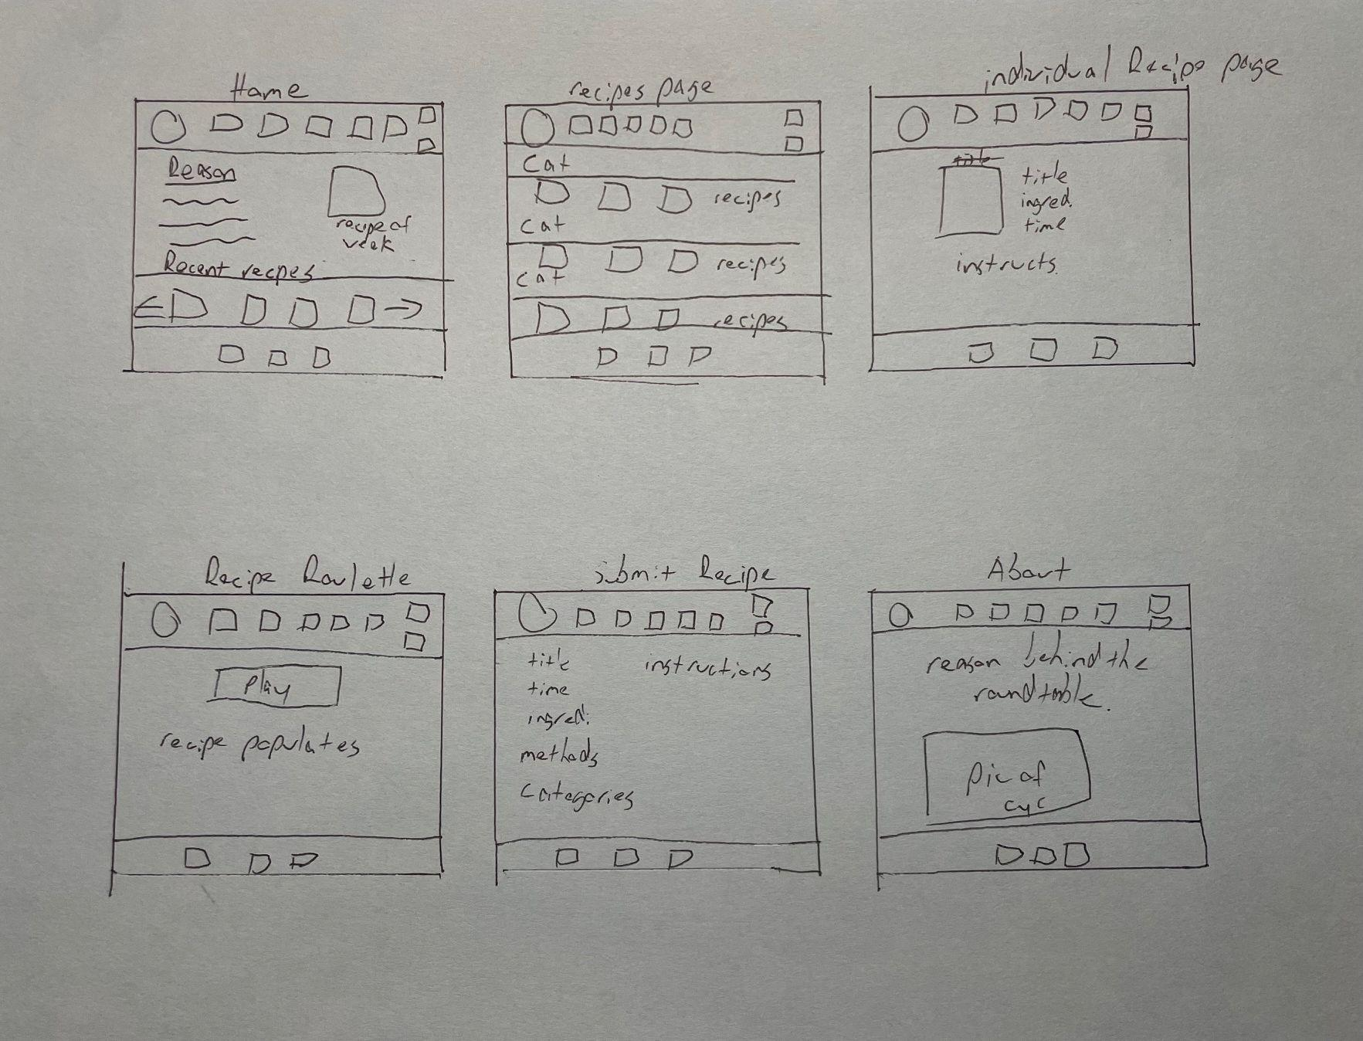
WireFrame Design
Notes:
© Copyright PresentationGO.com – Free Templates & Infographics for PowerPoint and Google Slides

Slide 17
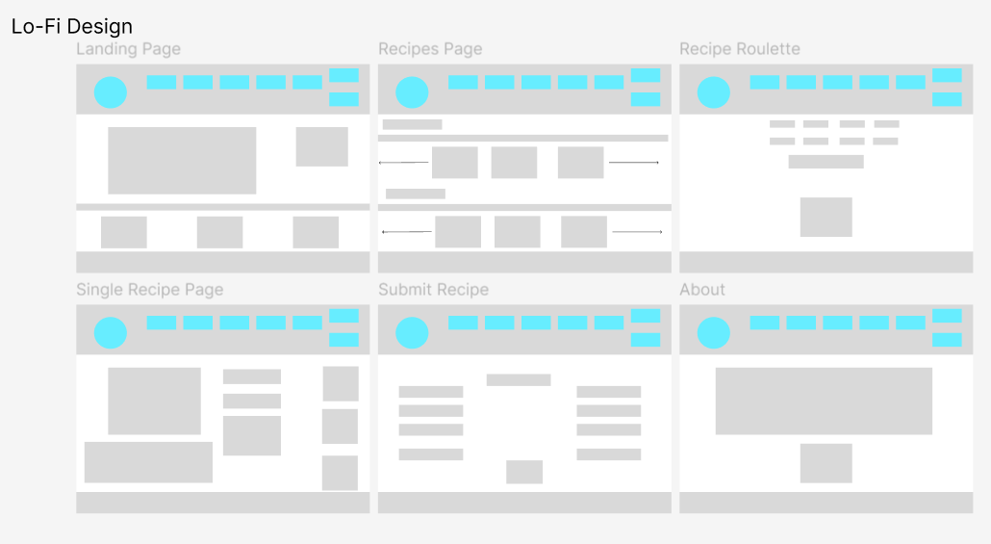
WireFrame Design
Notes:
© Copyright PresentationGO.com – Free Templates & Infographics for PowerPoint and Google Slides

Slide 18
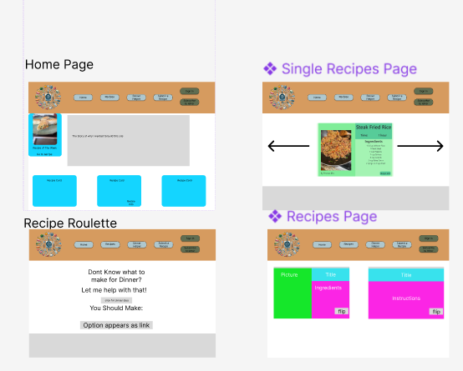
WireFrame Design: Original hi-fi
Notes:
© Copyright PresentationGO.com – Free Templates & Infographics for PowerPoint and Google Slides

Slide 19
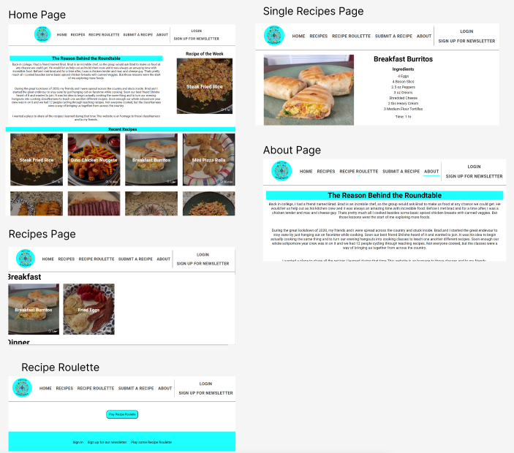
WireFrame Design Current State
Notes:
© Copyright PresentationGO.com – Free Templates & Infographics for PowerPoint and Google Slides

Slide 20
Scope
Notes:
© Copyright PresentationGO.com – Free Templates & Infographics for PowerPoint and Google Slides

Slide 21
In Scope
Users can browse recipes from front page
Users can find the recipe of the week
Users can find recipes categorized by meal type
Users can play Recipe Roulette to find a random meal to make
Users can submit a recipe
Users can read recipe details and see an image of the final product
Notes:
© Copyright PresentationGO.com – Free Templates & Infographics for PowerPoint and Google Slides

Slide 22
Out of Scope
Optimization for Mobile - The site is available on any screen size, but mobile optimization has not been implemented.
User authentication and authorization - user features have not been implemented and authentication processes are required to implement
Email newsletters - newsletter signup with implementation through mailchimp
Linking with a CMS to manage dynamic site changes.
Notes:
© Copyright PresentationGO.com – Free Templates & Infographics for PowerPoint and Google Slides

Slide 23
Open Questions
Adding pagination or carousels to the recipes page once there are many more recipes.
Would love to adjust styling and make plating/images more uniform and themed
Adding links to video tutorials for each recipe.
Adding measurement calculators for when you wish to halve or increase the portion sizes.
Adding measurement toggles to switch between metric and imperial measuring
Notes:
© Copyright PresentationGO.com – Free Templates & Infographics for PowerPoint and Google Slides

Slide 24
Open Questions
Adding articles about food science and nutrition
Creating a recipe fusion idea boards similar to pinterest
Adding videos showing different culinary skills
And many many more.
Notes:
© Copyright PresentationGO.com – Free Templates & Infographics for PowerPoint and Google Slides

Slide 25
Non-Functional Requirements
Login - Currently no way to log in
Recipe Roulette - Currently this is roulette in its truest form, completely random. I would like users to be able to “cheat” a bit and select desires or restrictions for their meal.
Security measures like encryption need to be implemented before users are fully integrated so their profiles are secure.
Locally ran - AWS would not accept my github. There are many features I would like implemented for other people to truly enjoy the site and it works for my purposes as is, so this was not high on the priority list.
Notes:
© Copyright PresentationGO.com – Free Templates & Infographics for PowerPoint and Google Slides

Slide 26
Project Planning
Notes:
© Copyright PresentationGO.com – Free Templates & Infographics for PowerPoint and Google Slides

Slide 27
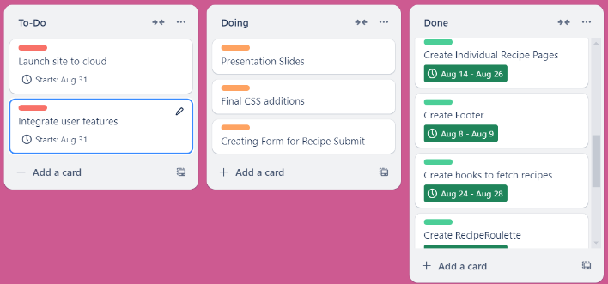
Trello Board
Notes:
© Copyright PresentationGO.com – Free Templates & Infographics for PowerPoint and Google Slides

Slide 28
Testing
Followed Figma and Draw.io designs
Front-End tested meticulously with console.logs to ensure data is returning correctly and not causing too many renders
Components were tested and any errors were resolved at the time of encounter
Regular use of try catch other error handling within the code
Thunderclient used to test CRUD operations
Tested the application as a user to ensure no errors occurred.
Notes:
© Copyright PresentationGO.com – Free Templates & Infographics for PowerPoint and Google Slides

Slide 29
Implementation
The application is locally ran using react for the front end and MongoDB in the backend connected to docker.
Instructions to set up your own instance can be found in the documentation.
Notes:
© Copyright PresentationGO.com – Free Templates & Infographics for PowerPoint and Google Slides

Slide 30
References
Github Repository: https://github.com/ThomasEllis1994/Recipe-RoundTable
MongoDB Compass:https://www.mongodb.com/try/download/shell
Docker Desktop:https://www.docker.com/products/docker-desktop/
Statistics: https://www.testhut.com/how-many-americans-cook-statistics/
Slide template: https://www.presentationgo.com/presentation/artisan-bakery-template-powerpoint-google-slides/
Notes:
© Copyright PresentationGO.com – Free Templates & Infographics for PowerPoint and Google Slides

Slide 31
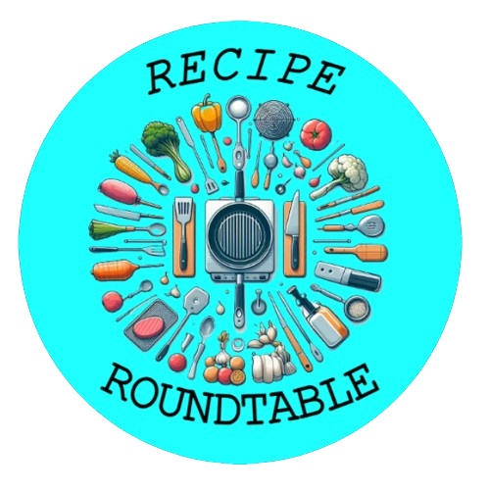
Thank You!
Time for a demo
Notes:
© Copyright PresentationGO.com – Free Templates & Infographics for PowerPoint and Google Slides

